Slide 1

AVOIDING THE OWASP
Top 10 security exploits
Friday 11, Dec 2020

Slide 2
ME
Certified Penetration Testing Engineer
Certified Ethical Hacker
Master’s in Information Technology (CyberSec)
Friday 11, Dec 2020

Slide 3

SECURITY
Friday 11, Dec 2020

Slide 4
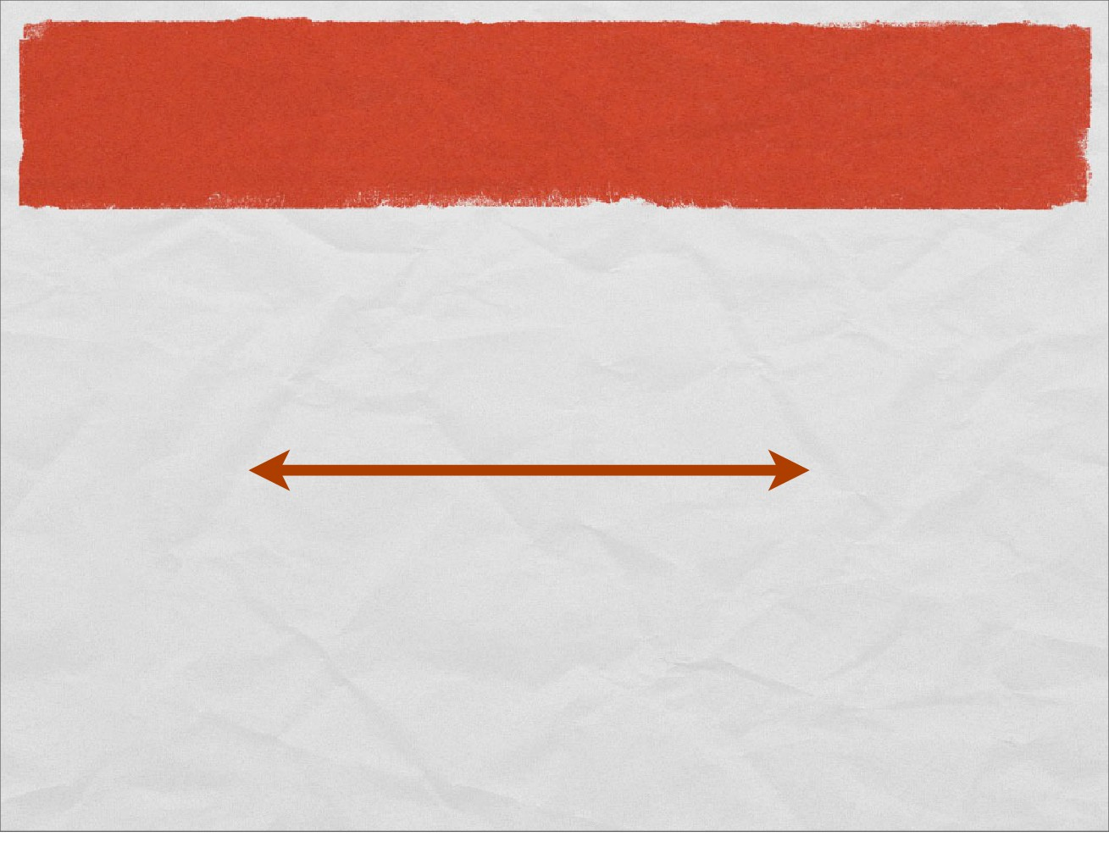
SECURITY CONTINUUM
(
)
unusable
unrestricted
Friday 11, Dec 2020

Slide 5
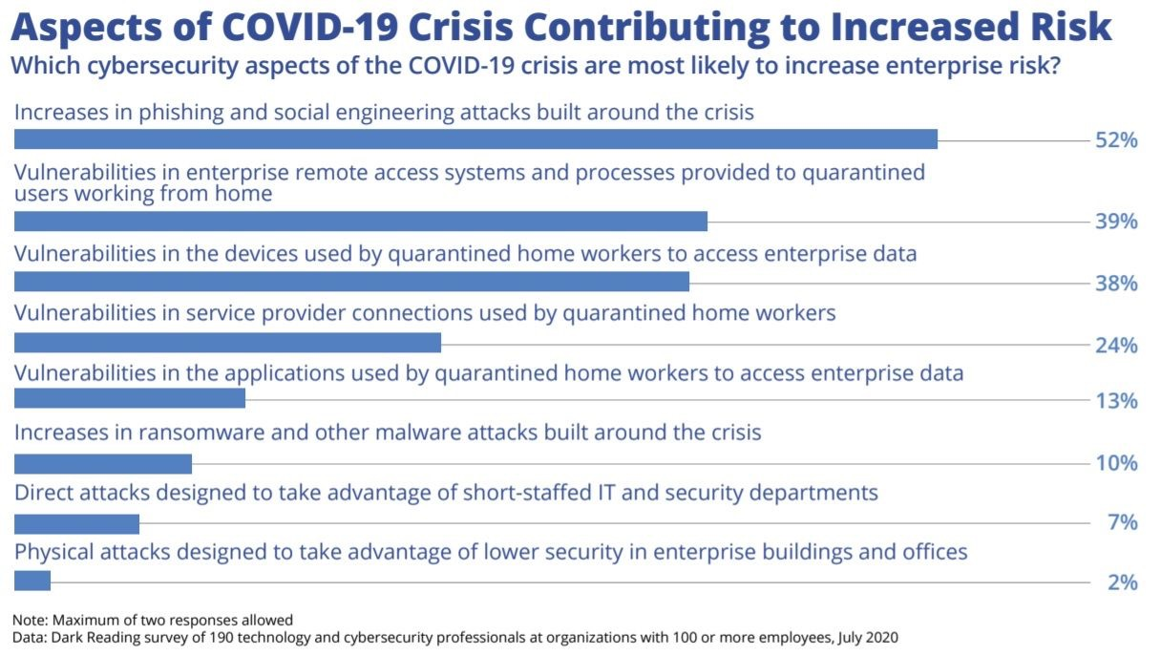
Some Statistics on Security
Friday 11, Dec 2020

Slide 6
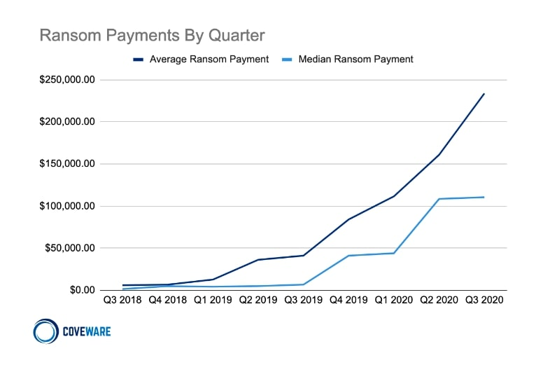
Some Statistics on Security
Friday 11, Dec 2020

Slide 7
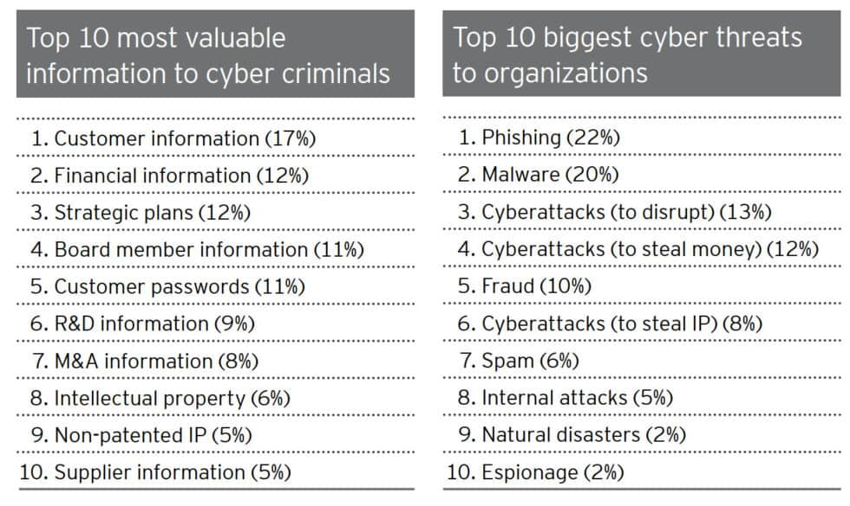
Some Statistics on Security
Friday 11, Dec 2020

Slide 8

OWASP
Open Web Application Security Project
Worldwide non-profit organization aimed to improve security.
Reaches out to all developers, IT personnel and individuals, not just security professionals.
All material is free and easily accessible.
Friday 11, Dec 2020

Slide 9

OWASP TOP 10
Friday 11, Dec 2020

Slide 10
INJECTION
‘ OR 1=1 ‘--
Friday 11, Dec 2020

Slide 11

RISKS
Permits query manipulation and arbitrary SQL.
Command - Permits use of shell commands.
Attackers can run code/queries for unauthorized access.
Friday 11, Dec 2020

Slide 12
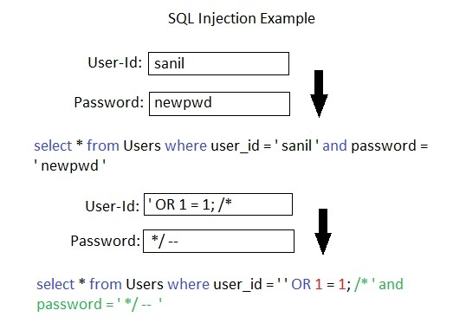
SQL INJECTION EXAMPLE
Friday 11, Dec 2020

Slide 13
PREVENTION
"Connections" between systems are highly vulnerable
Always assume data coming in could be "evil“ be sure to include "evil" use cases and user stories in your design
Sanitize and Validate user submitted data.
If user-input text is needed, use parameterized queries clean up quotes, parenthesis, and SQL comments
Friday 11, Dec 2020

Slide 14
BROKEN AUTHENTICATION & SESSION MANAGEMENT
/index.php?PHPSESSID=pwned
Friday 11, Dec 2020

Slide 15
RISKS
Identity theft.
Access to unauthorized and sensitive data.
Attackers can steal a cookie for session hijacking.
Possible brute force attack utilizing data breaches.
Friday 11, Dec 2020

Slide 16
SESSION & COOKIES
Http is a “stateless” protocol.
Store the state with session (server) and cookies (client).
Session IDs are stored in cookies or url.
Packet Sniffing, HttpReferrer Logs, etc.
Friday 11, Dec 2020

Slide 17
PREVENTION
Implement updated SSL/TLS everywhere.
Have cryptographically strong session ID.
Use two-factor authentication wherever possible.
Use rate limiting for repeated login attempts.
Friday 11, Dec 2020

Slide 18
XSS
<script>alert(‘cross site scripting’);</script>
Friday 11, Dec 2020

Slide 19
RISKS
Can be used to run malicious scripts on website.
Can lead to multiple kinds of attack.
Used to steal session cookies.
Combined with phishing, it can be used to steal sensitive data .
Friday 11, Dec 2020

Slide 20
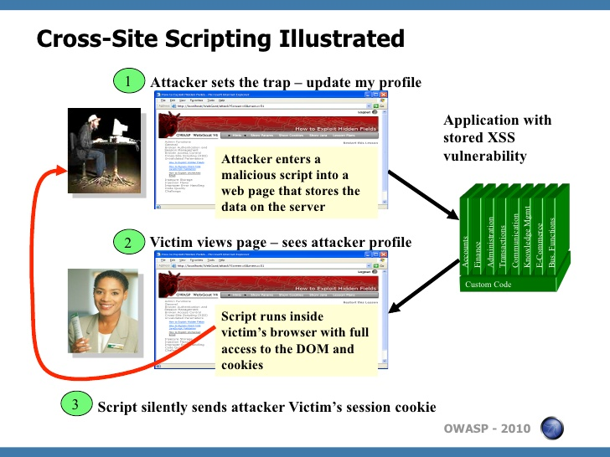
XSS EXAMPLE
Friday 11, Dec 2020

Slide 21
PREVENTION
Never, ever, ever trust user submitted data (e.g. URLs, web forms, comment threads, etc.)
Implement content security policy.
Set HttpOnly flag.
Convert special characters such as ?, &, /, <, > and spaces to their respective HTML or URL encoded equivalents.
Friday 11, Dec 2020

Slide 22
Q & A
Friday 11, Dec 2020

Slide 23
THANK YOU!
Friday 11, Dec 2020

